Slide 1
The Name of the Game
By Daniel Reiter

Slide 2
Video Game Market
Billion Dollar Industry
Different markets, different preferences
Lots of competition, lots of turnover
Hard to stay successful

Slide 3
The Project
Using kaggle datasets, find out what types of games sell best Globally and in the 3 major areas: North America, Europe and Japan
Delve into what genres as well as consoles that gamers prefer
Look into the impact of Critic and User scores including common words in reviews

Slide 4
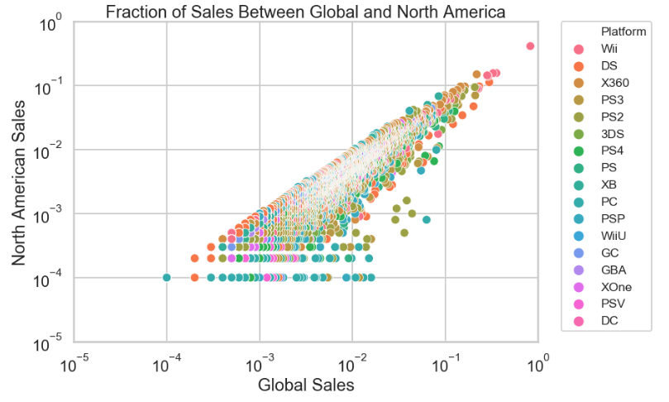
Global vs. North American Sales
Strong positive correlation between the two
Pearson correlation coefficient around 0.96
Global Sales is predictive of North American Sales

Slide 5
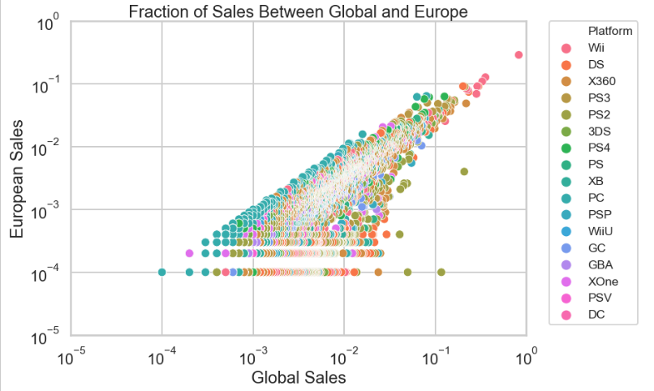
Global vs. European Sales
Another example of strong positive correlation
Coefficient around 0.94
Predictive Again

Slide 6
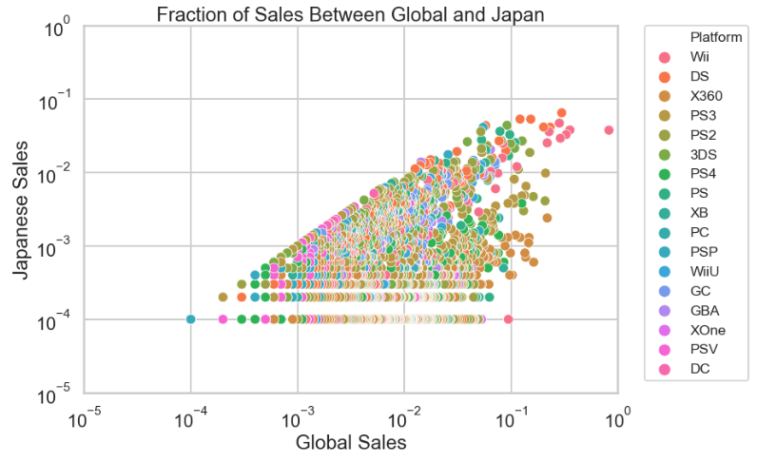
Global vs. Japanese Sales
Positive correlation but not as strong
This time around 0.61
Not quite as predictive

Slide 7
Digging Deeper
It is not just the relationship with Global Sales
North America and Europe have a strong positive correlation, around 0.84
But Japan has weaker relationships with each (around 0.47 and 0.52)
So which genres and platforms drive sales?

Slide 8
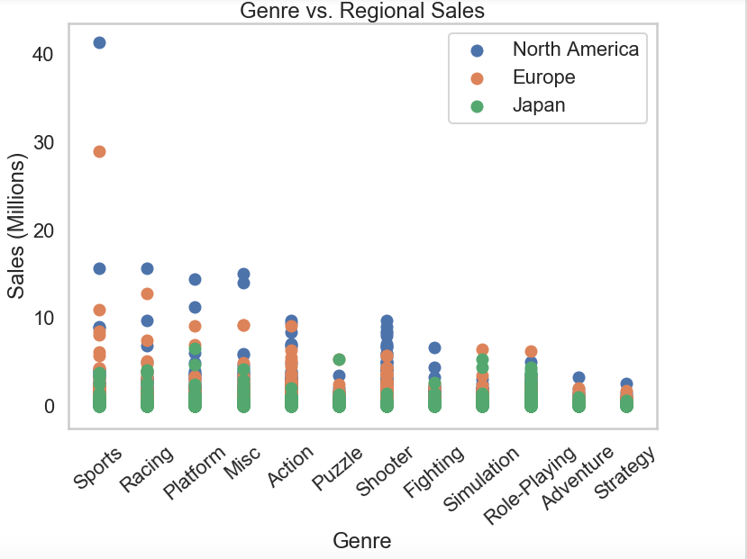
Genre vs. Regional Sales
Sports, Racing and Platform near the front
RPG, Adventure and Strategy games near the end
Why Shooters in the middle?

Slide 9
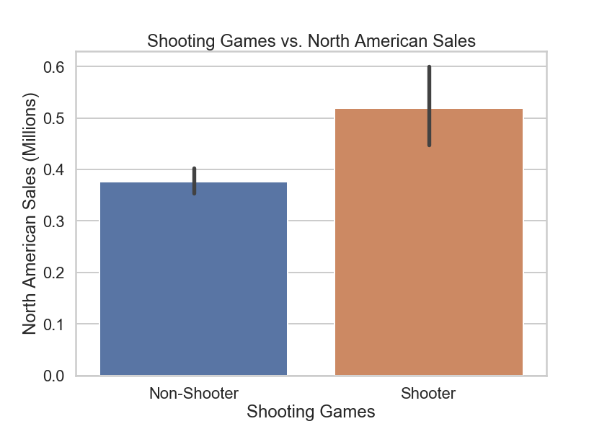
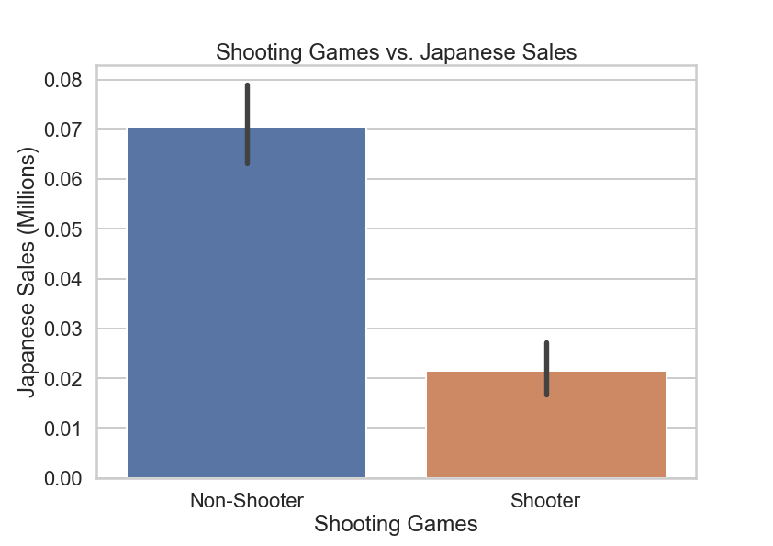
North America vs. Japan

Slide 10
Not Just The Plot
Even in t-scores, Japan is the difference
Shooters sold better Globally as well as in North America and Europe
But sold worse in Japan
Explains being in the middle of the spectrum

Slide 11
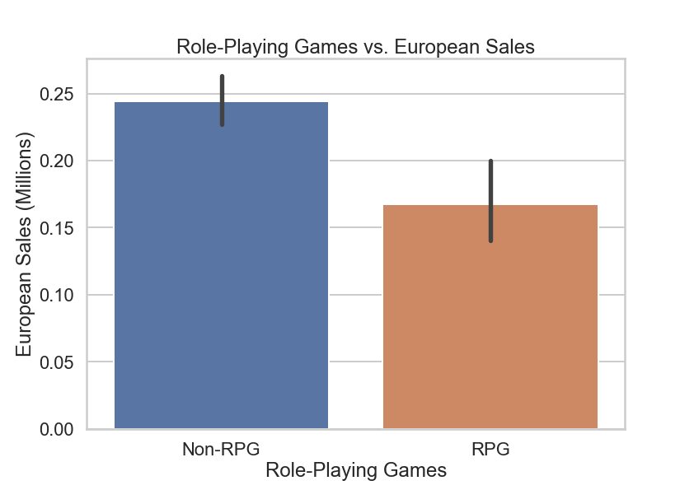
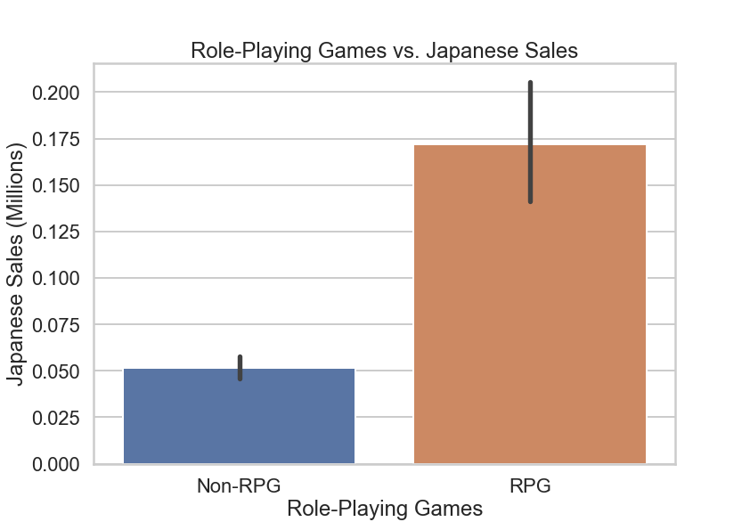
Europe vs. Japan

Slide 12
Japan Loves RPGs!
Japan was the only region that had a positive t-score
North America and Europe each had negative t-scores
RPGs sold better in Japan but worse in the other major regions

Slide 13
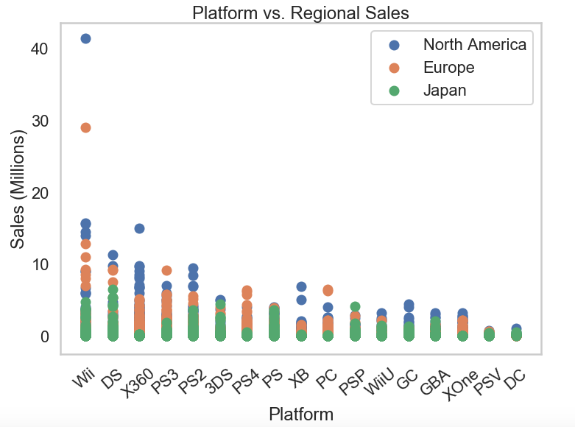
Platform vs. Regional Sales
Games on Nintendo Wii and DS sold best
Xbox 360, PS2 and PS3 not far behind
Overall not too surprising

Slide 14
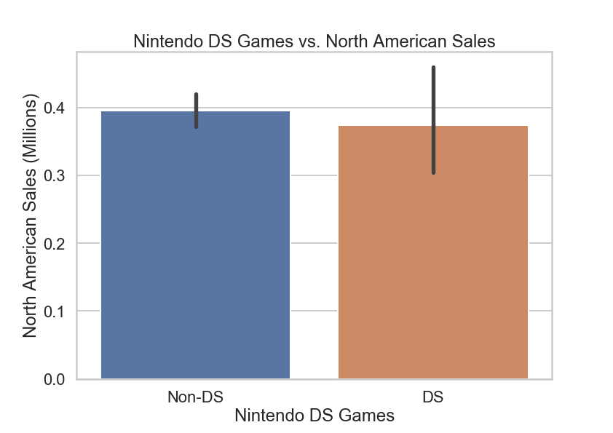
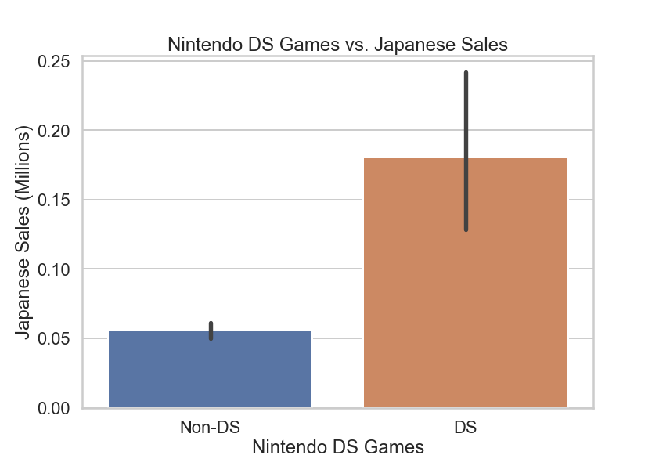
North America vs. Japan

Slide 15
Japan & Nintendo
Nintendo DS games sales only saw statistical significance in Japan, where they sold better
While Nintendo Wii games would make sense (especially “Wii Sports”), DS games are surprising
Japan helps push Nintendo to the top

Slide 16
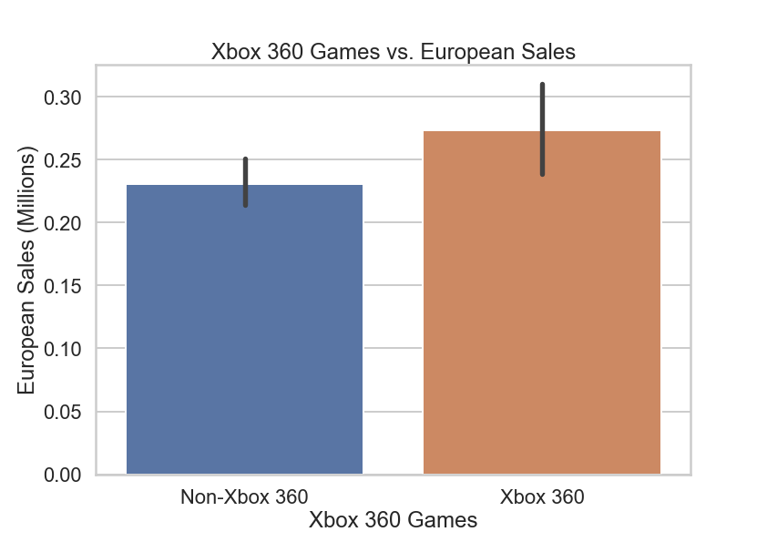
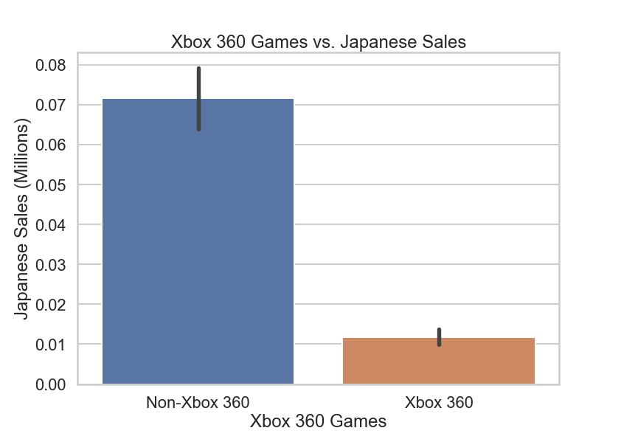
Europe vs. Japan

Slide 17
Microsoft != Japan?
Every region saw a positive t-score for Xbox 360 games except for Japan
Much like the Shooter genre, explains why it is not higher on the spectrum
Overall Microsoft struggles in Japan
How important are reviews?

Slide 18
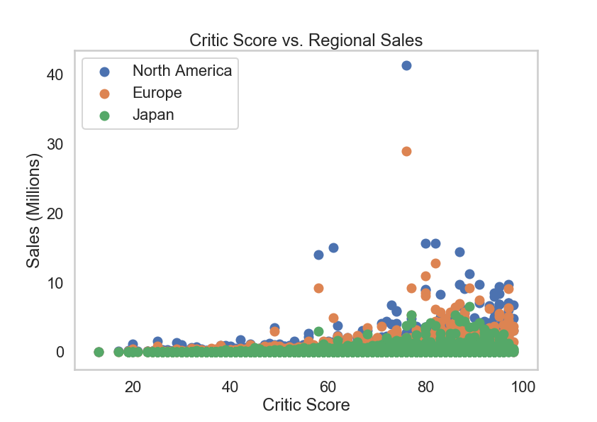
Critic Score vs. Regional Sales
Much of what is expected
Sweet spot seems to be around 80%
While all sales had positive correlation, each was lower than 0.25

Slide 19
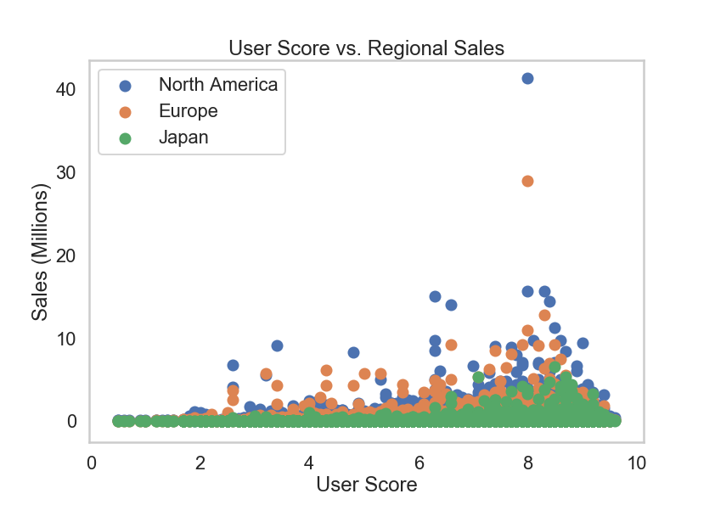
User Score vs. Regional Sales
Similar to Critic scores, best around 80%
Once again, all had small positive correlations; lower than 0.15
Japan was the only one with better correlation for User Score than Critic Score

Slide 20
Data Story Summary
Japan has the weakest correlation with Global Sales
But its impact is important for Genre and Platform sales
Critic and User scores had expected outcome but best sales not around 100%

Slide 21
More Information
Plenty more interesting plots/t-scores
Focused on main core about North America and Europe vs. Japan
Also looked into relationships between Genre, Developer and Rating with each being statistically significant

Slide 22
Machine Learning Analysis
Used Random Forest for each of the major types of sales, sometimes used extra parameters
Also filtered with values greater than or equal to the median
Ran model on new data from University of Portsmouth with U.S. Sales info from 2004-2010

Slide 23
Global Sales
R^2 around 0.43, RMSE around 2.72
Major features include Critic Score as well as User Count and words like “mw,” “super” and “mario”
Filtered by Median: R^2 around 0.45, RMSE around 2.85
Similar feature importance, rise of word “kart”

Slide 24
North American Sales
R^2 around 0.43, RMSE around 1.33
Similar feature importance to Global Sales
Filtered by Median: R^2 around 0.16, RMSE around 1.51
Same important features, User Count having big impact

Slide 25
European Sales
R^2 around 0.38, RMSE around 0.93
Important features include User Count, PC games as well as words like “fifa”
Filtered by Median: R^2 around 0.33, RMSE around 0.85
Critic Score, “kart” and “mario” became very important

Slide 26
Japanese Sales
R^2 around 0.37, RMSE around 0.46
Nintendo and SquareSoft were some of most important features
Filtered by Median: Everything is the exact same
Value may be close to or exactly zero

Slide 27
ML Recap
R^2 and RMSE tended to get smaller with each type of sale
Brand names were words that stood out, publishers and developers low (except for Japan)
User Count had big impact on difference between test and prediction for most models

Slide 28
New Data
U.S. Sales info from 2004 to 2010
Does not have words from reviews
Has time when game came out during the year
Same process as earlier data

Slide 29
Random Forest Model
R^2 around 0.86, RMSE around 0.41
Most important features are blocks of the year when game came out (Block 4 is holidays)
Filtered by Median: R^2 around 0.92, RMSE around 0.42
Similar impactful features though some blocks dipped (like Block 2)

Slide 30
Issues/Next Steps
For main dataset, weaker models. Second one stronger but different features
Does not include games from older consoles
Could look into console sales, not just based on their games
More reviews, including critics

Slide 31
Conclusion
Release Window very important
Brand names and User Count extremely impactful in predictive modeling
Genre and Platform not as important
For more information: https://github.com/SportsReiter12/Data-Science/tree/master/Video%20Game%20Capstone%20Project

